Slide 1
XV15 data
Date: 3/18/2025

Slide 2
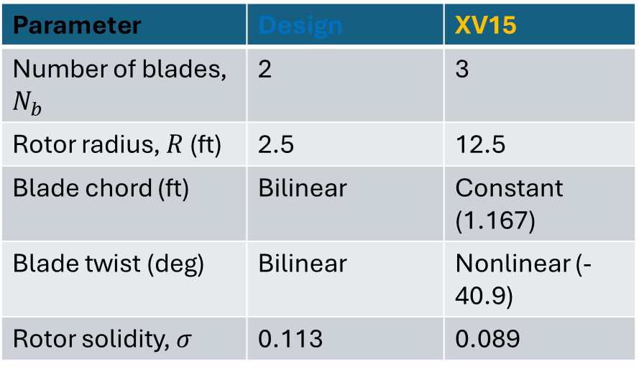
Comparison Rotor configuration
Parameter | Design | XV15
Number of blades, $N_{b}$ | 2 | 3
Rotor radius, $R$ (ft) | 2.5 | 12.5
Blade chord (ft) | Bilinear | Constant (1.167)
Blade twist (deg) | Bilinear | Nonlinear (-40.9)
Rotor solidity, $σ$ | 0.113 | 0.089
Reference: Felker, F. F., Betzina, M. D., & Signor, D. B. (1985). Performance and loads data from a hover test of a full-scale XV-15 rotor (No. NAS 1.15: 86833).

Slide 3
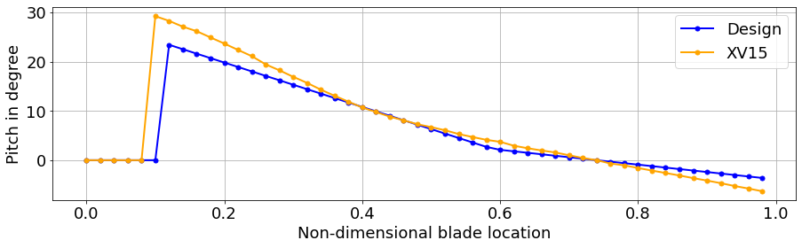
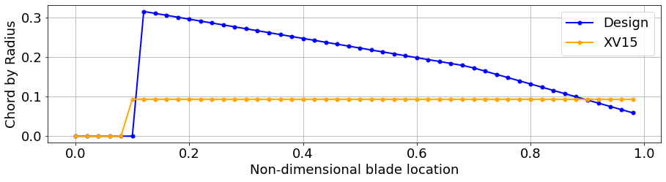
Pitch and Chord Distribution

Slide 4
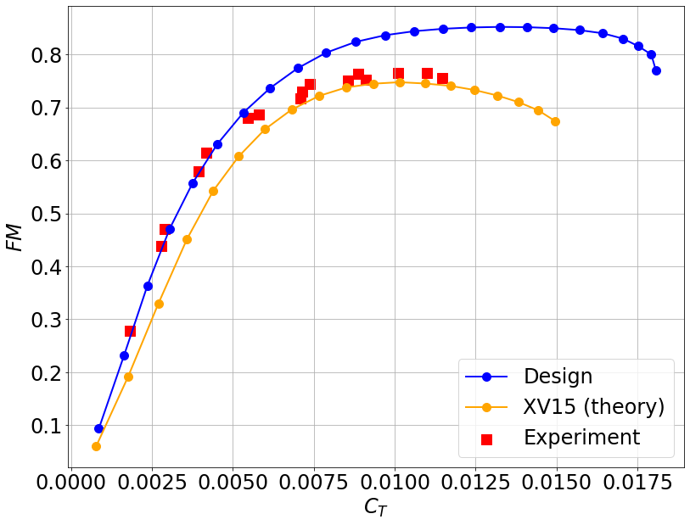
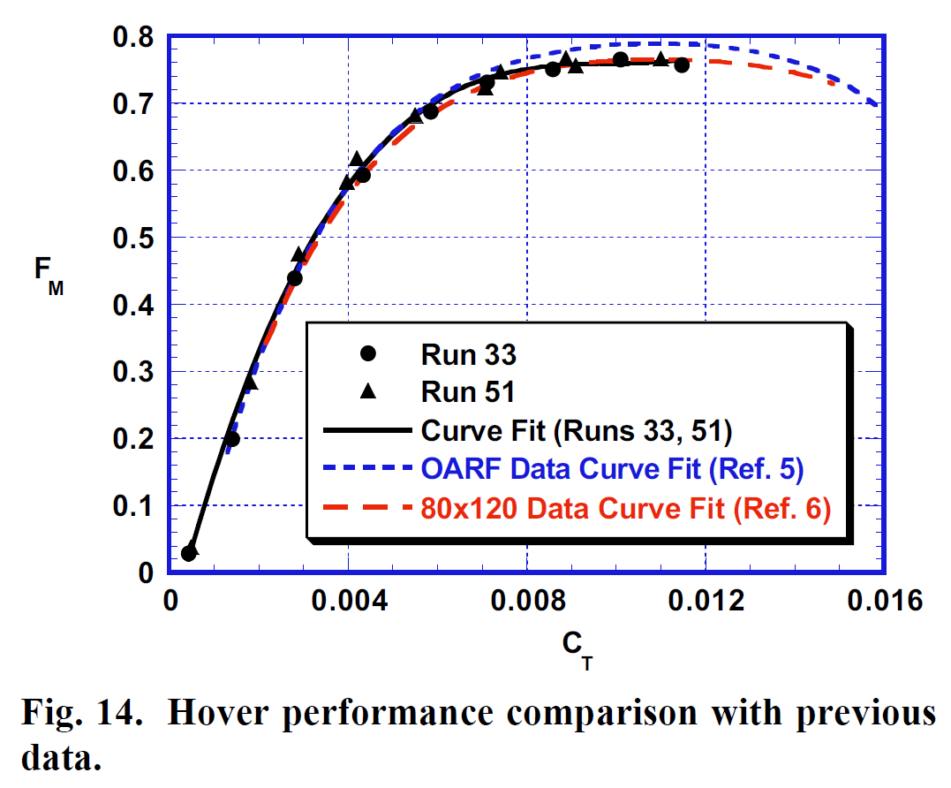

Comparison $FM$ vs $c_{T}$ ($θ_{0}=[−5°, 20°]$)
Reference: Betzina, M. D. (2002, January). Rotor performance of an isolated full-Scale XV-15 tiltrotor in helicopter mode. In American Helicopter Society Aerodynamics, Acoustics, and Test and Evaluation Technical Specialists Meeting, San Francisco, CA.

Slide 5
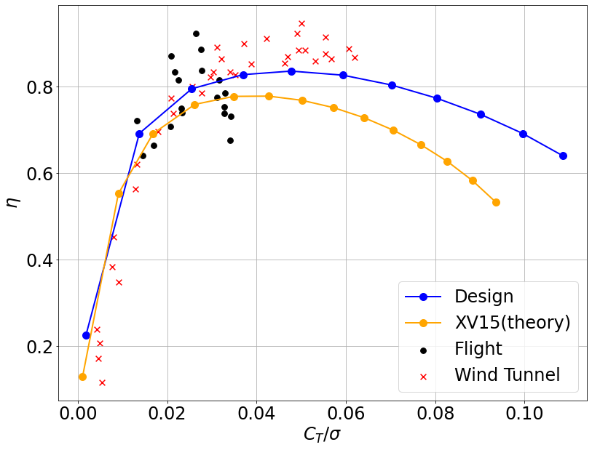
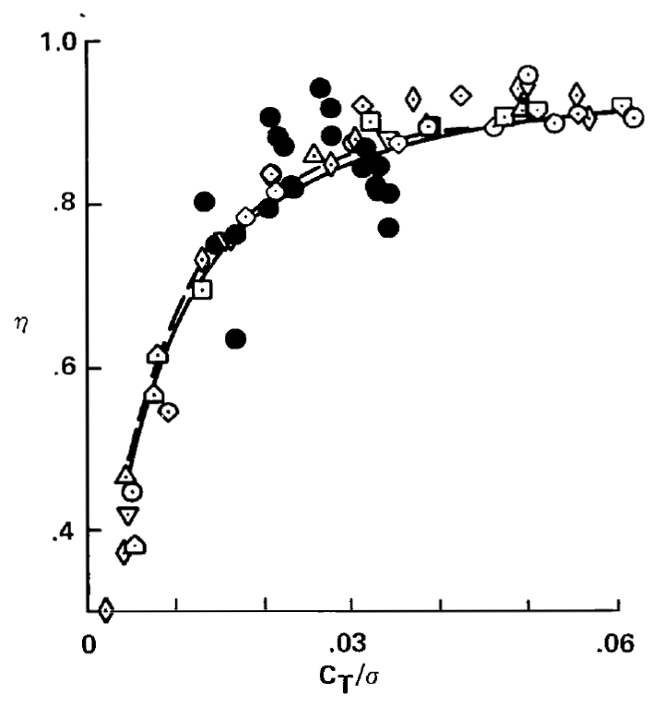
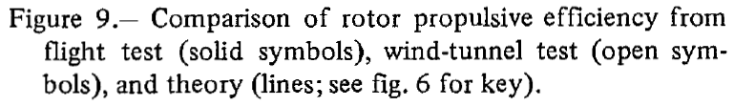
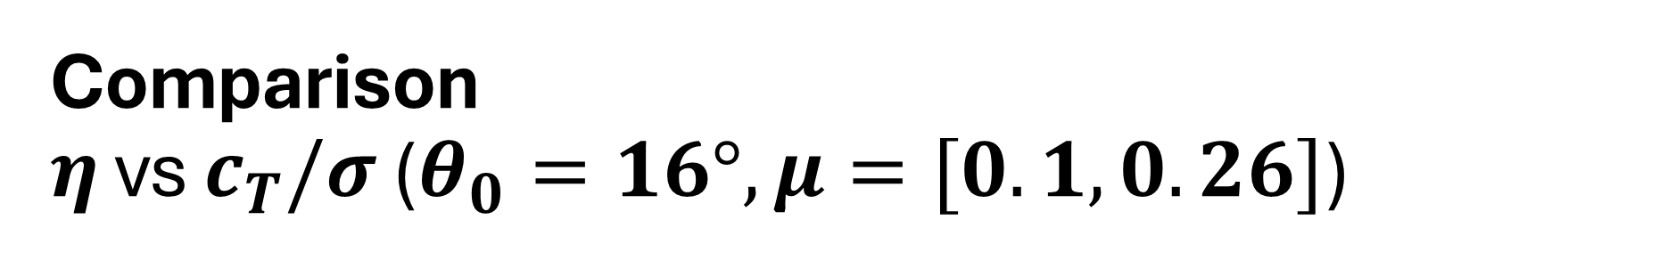
Comparison $η$ vs $c_{T}/σ$ ($θ_{0}=16°, μ=[0.1, 0.26]$)
Reference: Johnson, W. (1984). An assessment of the capability to calculate tilting prop-rotor aircraft performance, loads and stability (No. NAS 1.60: 2291).

